Slide 1

EDA Sales Analysis

Slide 2
Problem Statement
Sales teams often lack a clear, data-driven understanding of regional performance, making it difficult to identify growth opportunities and optimize resources. This project aims to analyse and visualize regional sales data to uncover trends, evaluate profitability, and support strategic decision-making.

Slide 3
Approach
Data Preparation → Collected sales, customer, and regional data; cleaned, merged, and standardised columns.
Exploratory Analysis → Used summary stats and visualisations to understand sales distribution, trends, and outliers.
Insights & Strategy → Summarised key findings to support growth opportunities and resource optimisation.

Slide 4
Data overview
Sales Orders: Transaction-level data with order dates, quantities, revenue, and costs.
Customers: Customer profiles linked to orders.
Products: Product catalog for mapping sales to items.
Regions & States: Geographic and demographic context (population, income, etc.).
Budgets (2017): Reference values to benchmark performance.

Slide 5
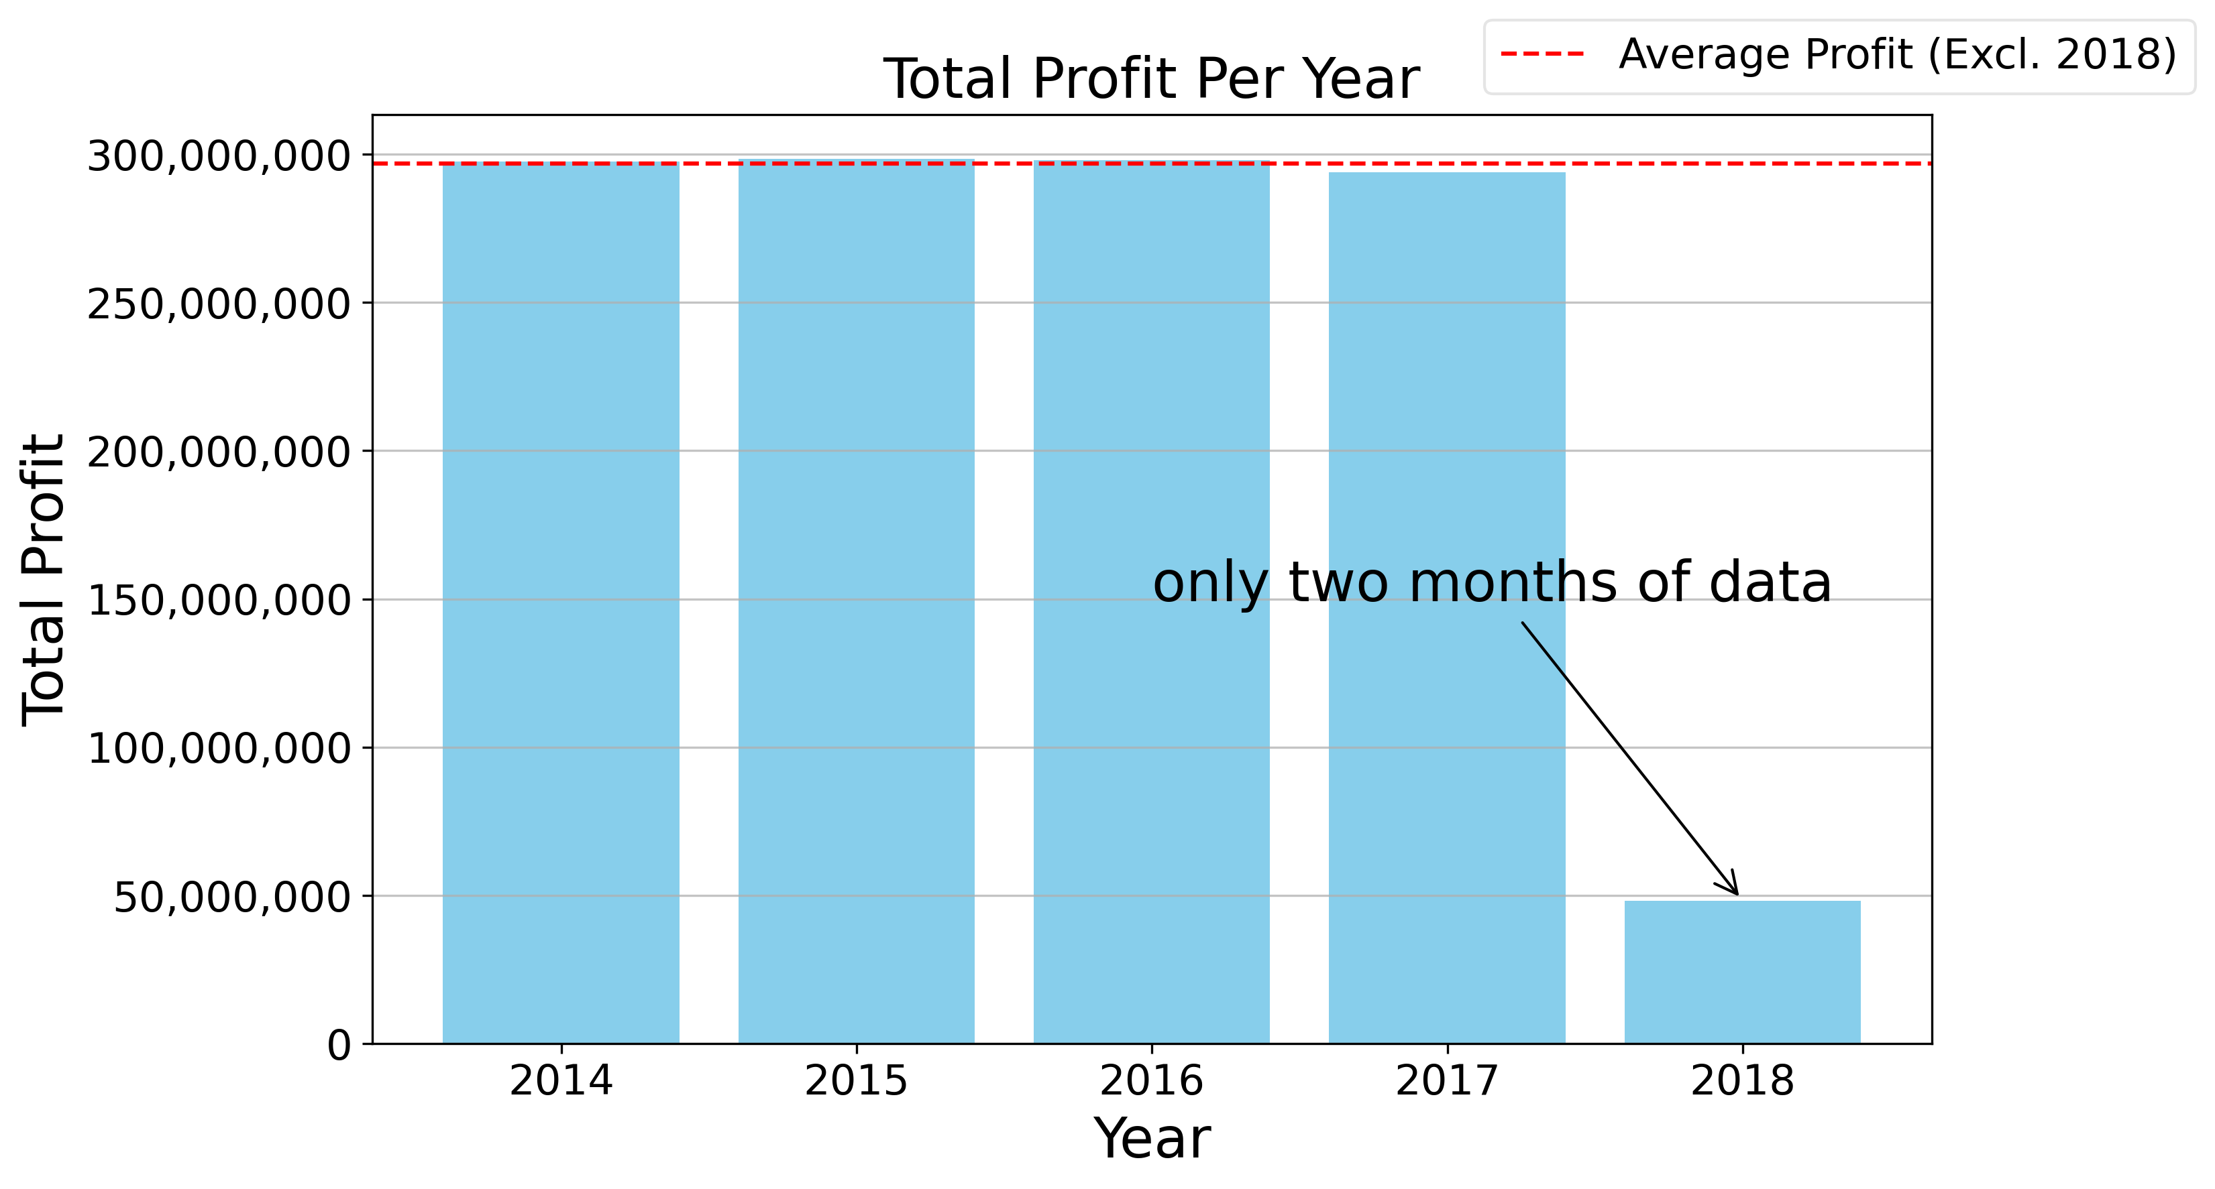
Total profit per year
2014-2017: Profits consistent year over year averaging at $296,959,736
2018: Sharp decline, caused by limited data (only 2 months)

Slide 6
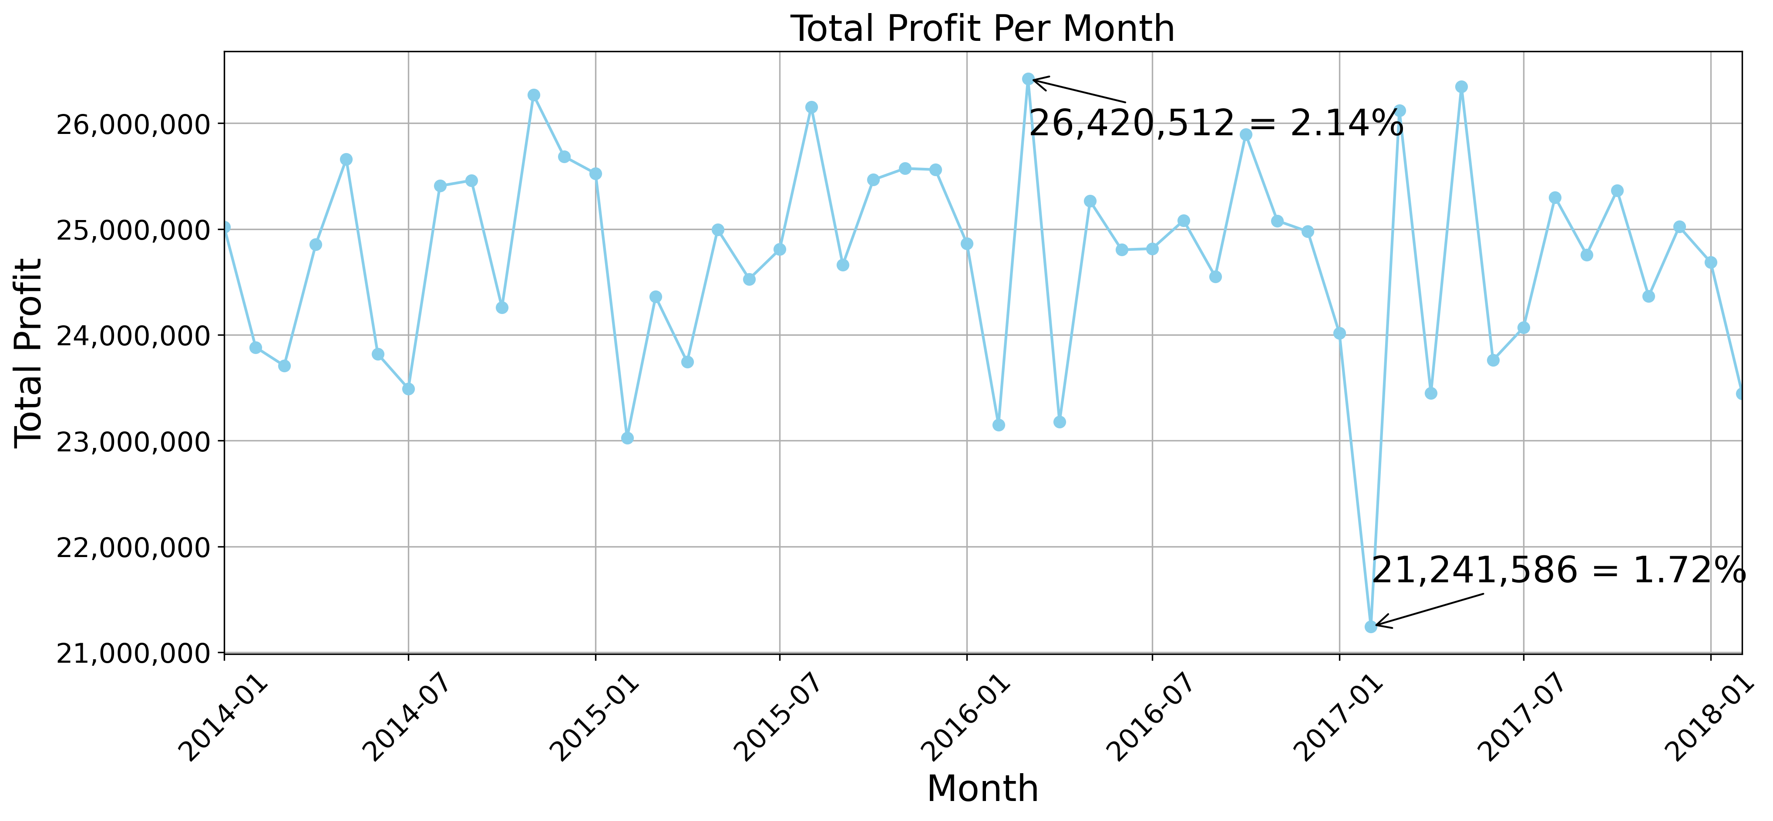
Total profit per month
Sales tend to decline after the holiday period.
Highest profit: $26,420,512 (2.14% of total profit) - March 2016
Lowest profit: $21,241,586 (1.72% of total profit) - February 2017

Slide 7
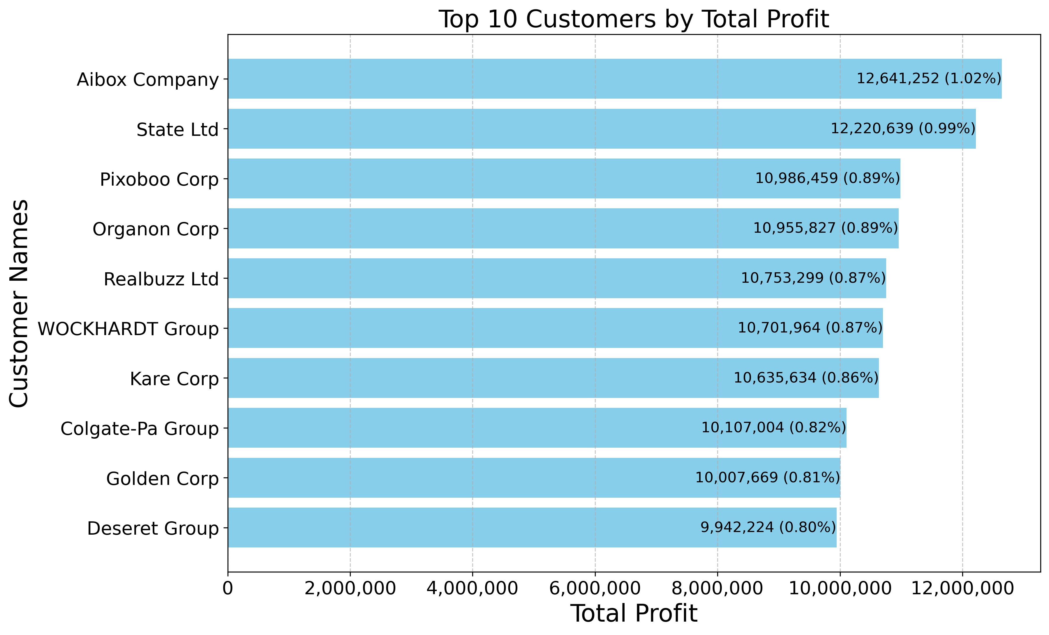
Top 10 customers
AiBox Company and State Ltd. generated over $12M in profits across 5 years (combined 2.01% of total profits).
Deseret Group was the only top-10 company with profits below $10M.

Slide 8
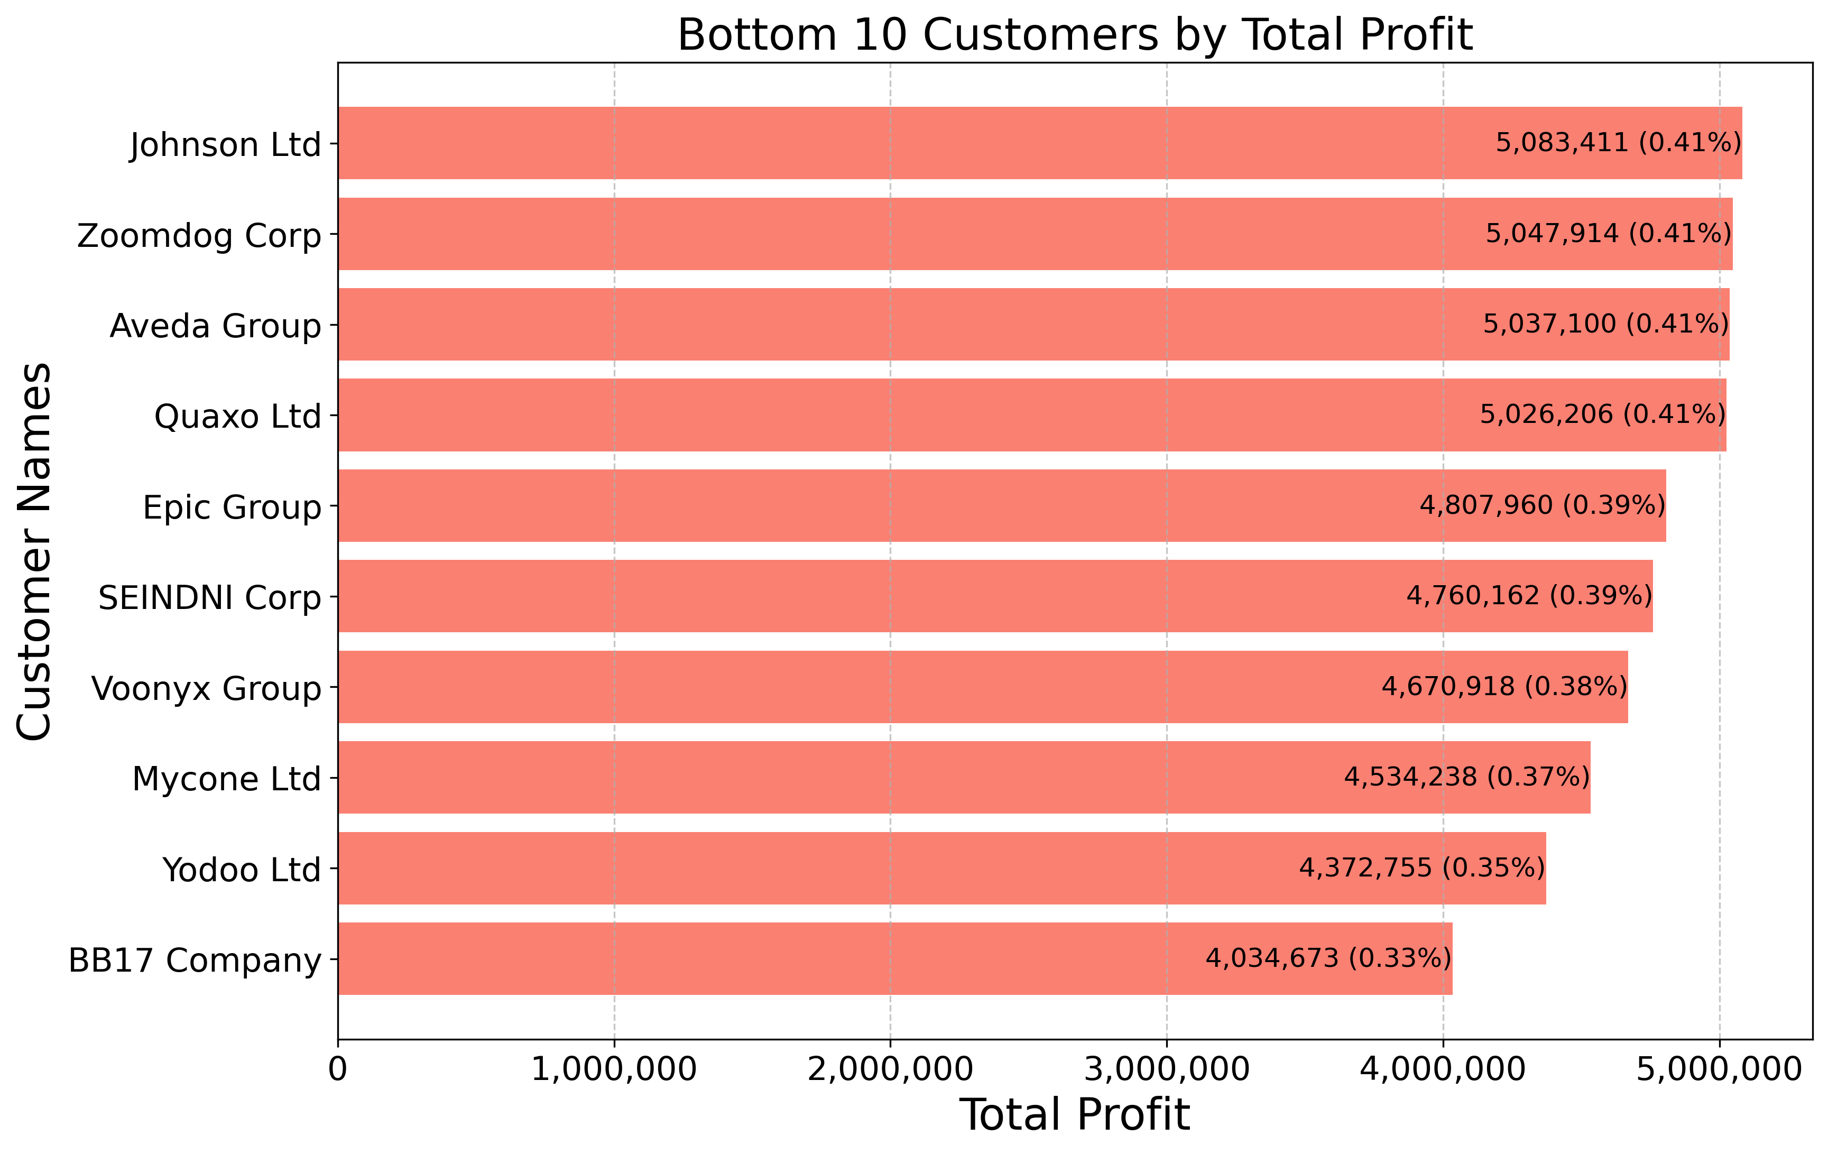
Bottom 10 customers
All bottom 10 customers contributed $5M or less in profit.
BB17 Company was the least profitable, with $4,034,673 (0.33% of total profit).

Slide 9
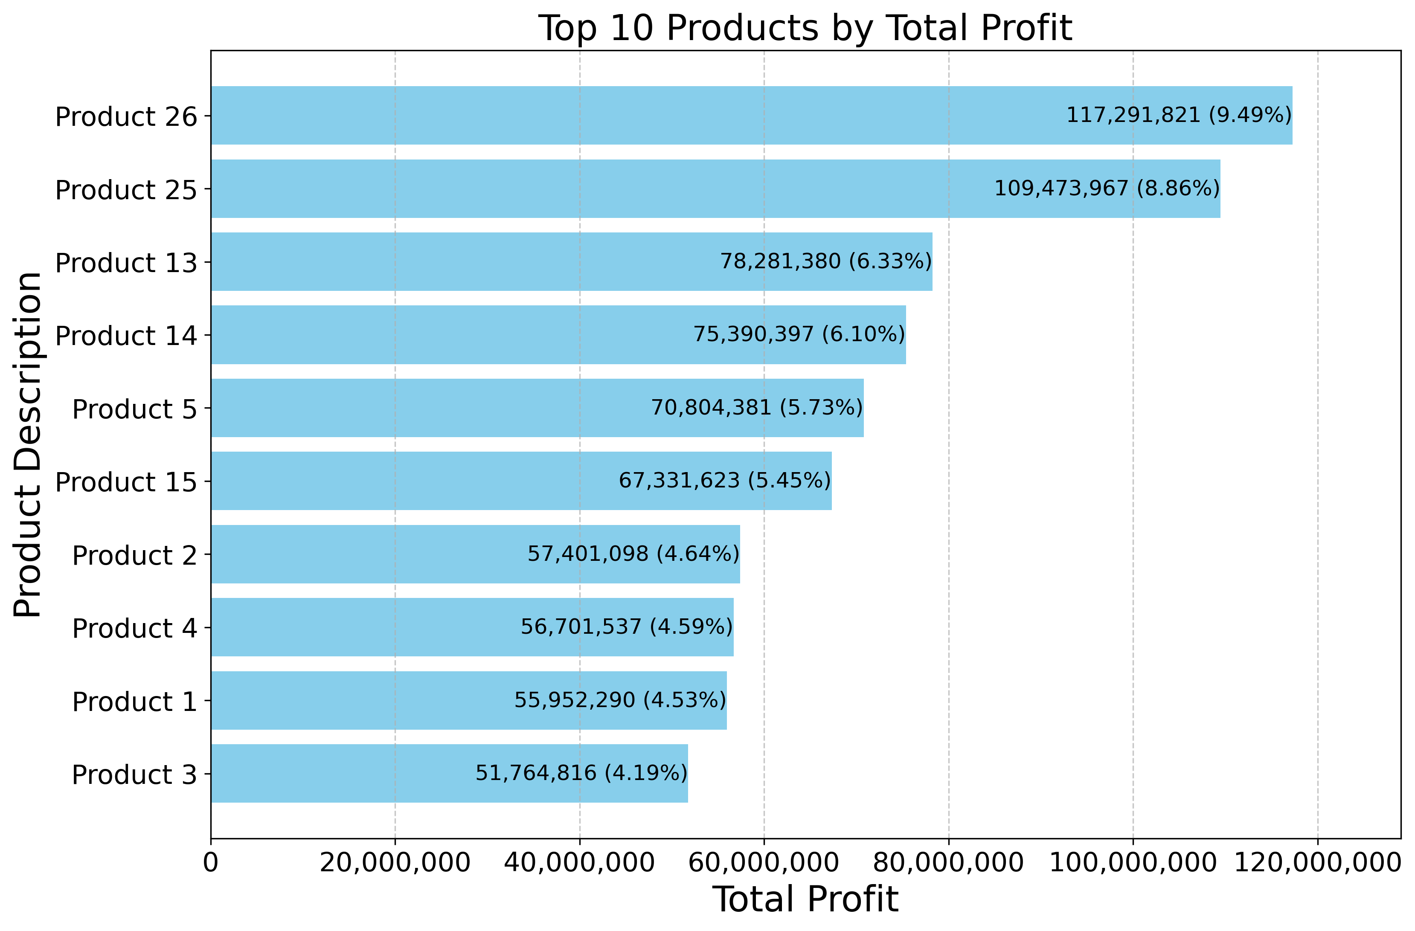
Top 10 products
All top-10 products generated more than $51 million in profit each.
Highest earning product: product 26 - $117,291,821 (9.49%)
Lowest earning product: product 3 - $51,764,816 (4.19%)

Slide 10
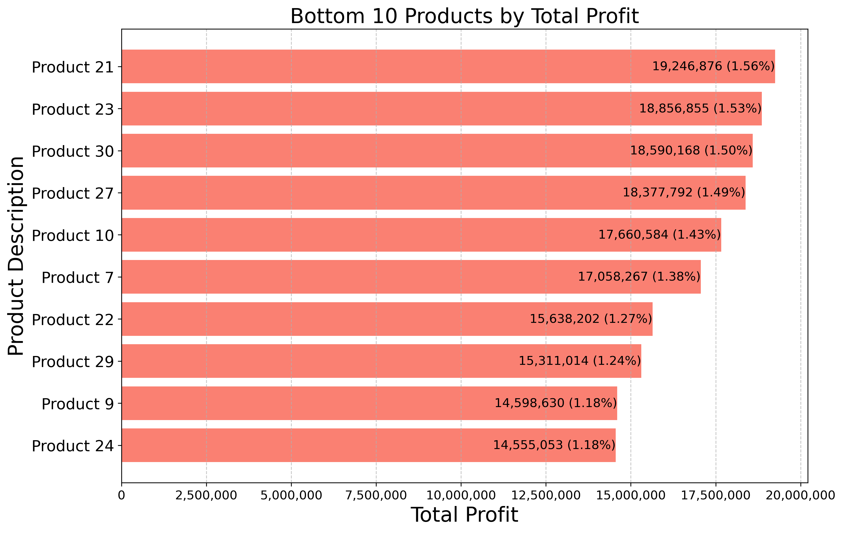
Bottom 10 products
All products in the bottom-10 contribute less than $20 million.
Highest earning product: product 21 - $19,246,876 (1.56%)
Lowest earning product: product 24 - $14,555,053 (1.18%)

Slide 11
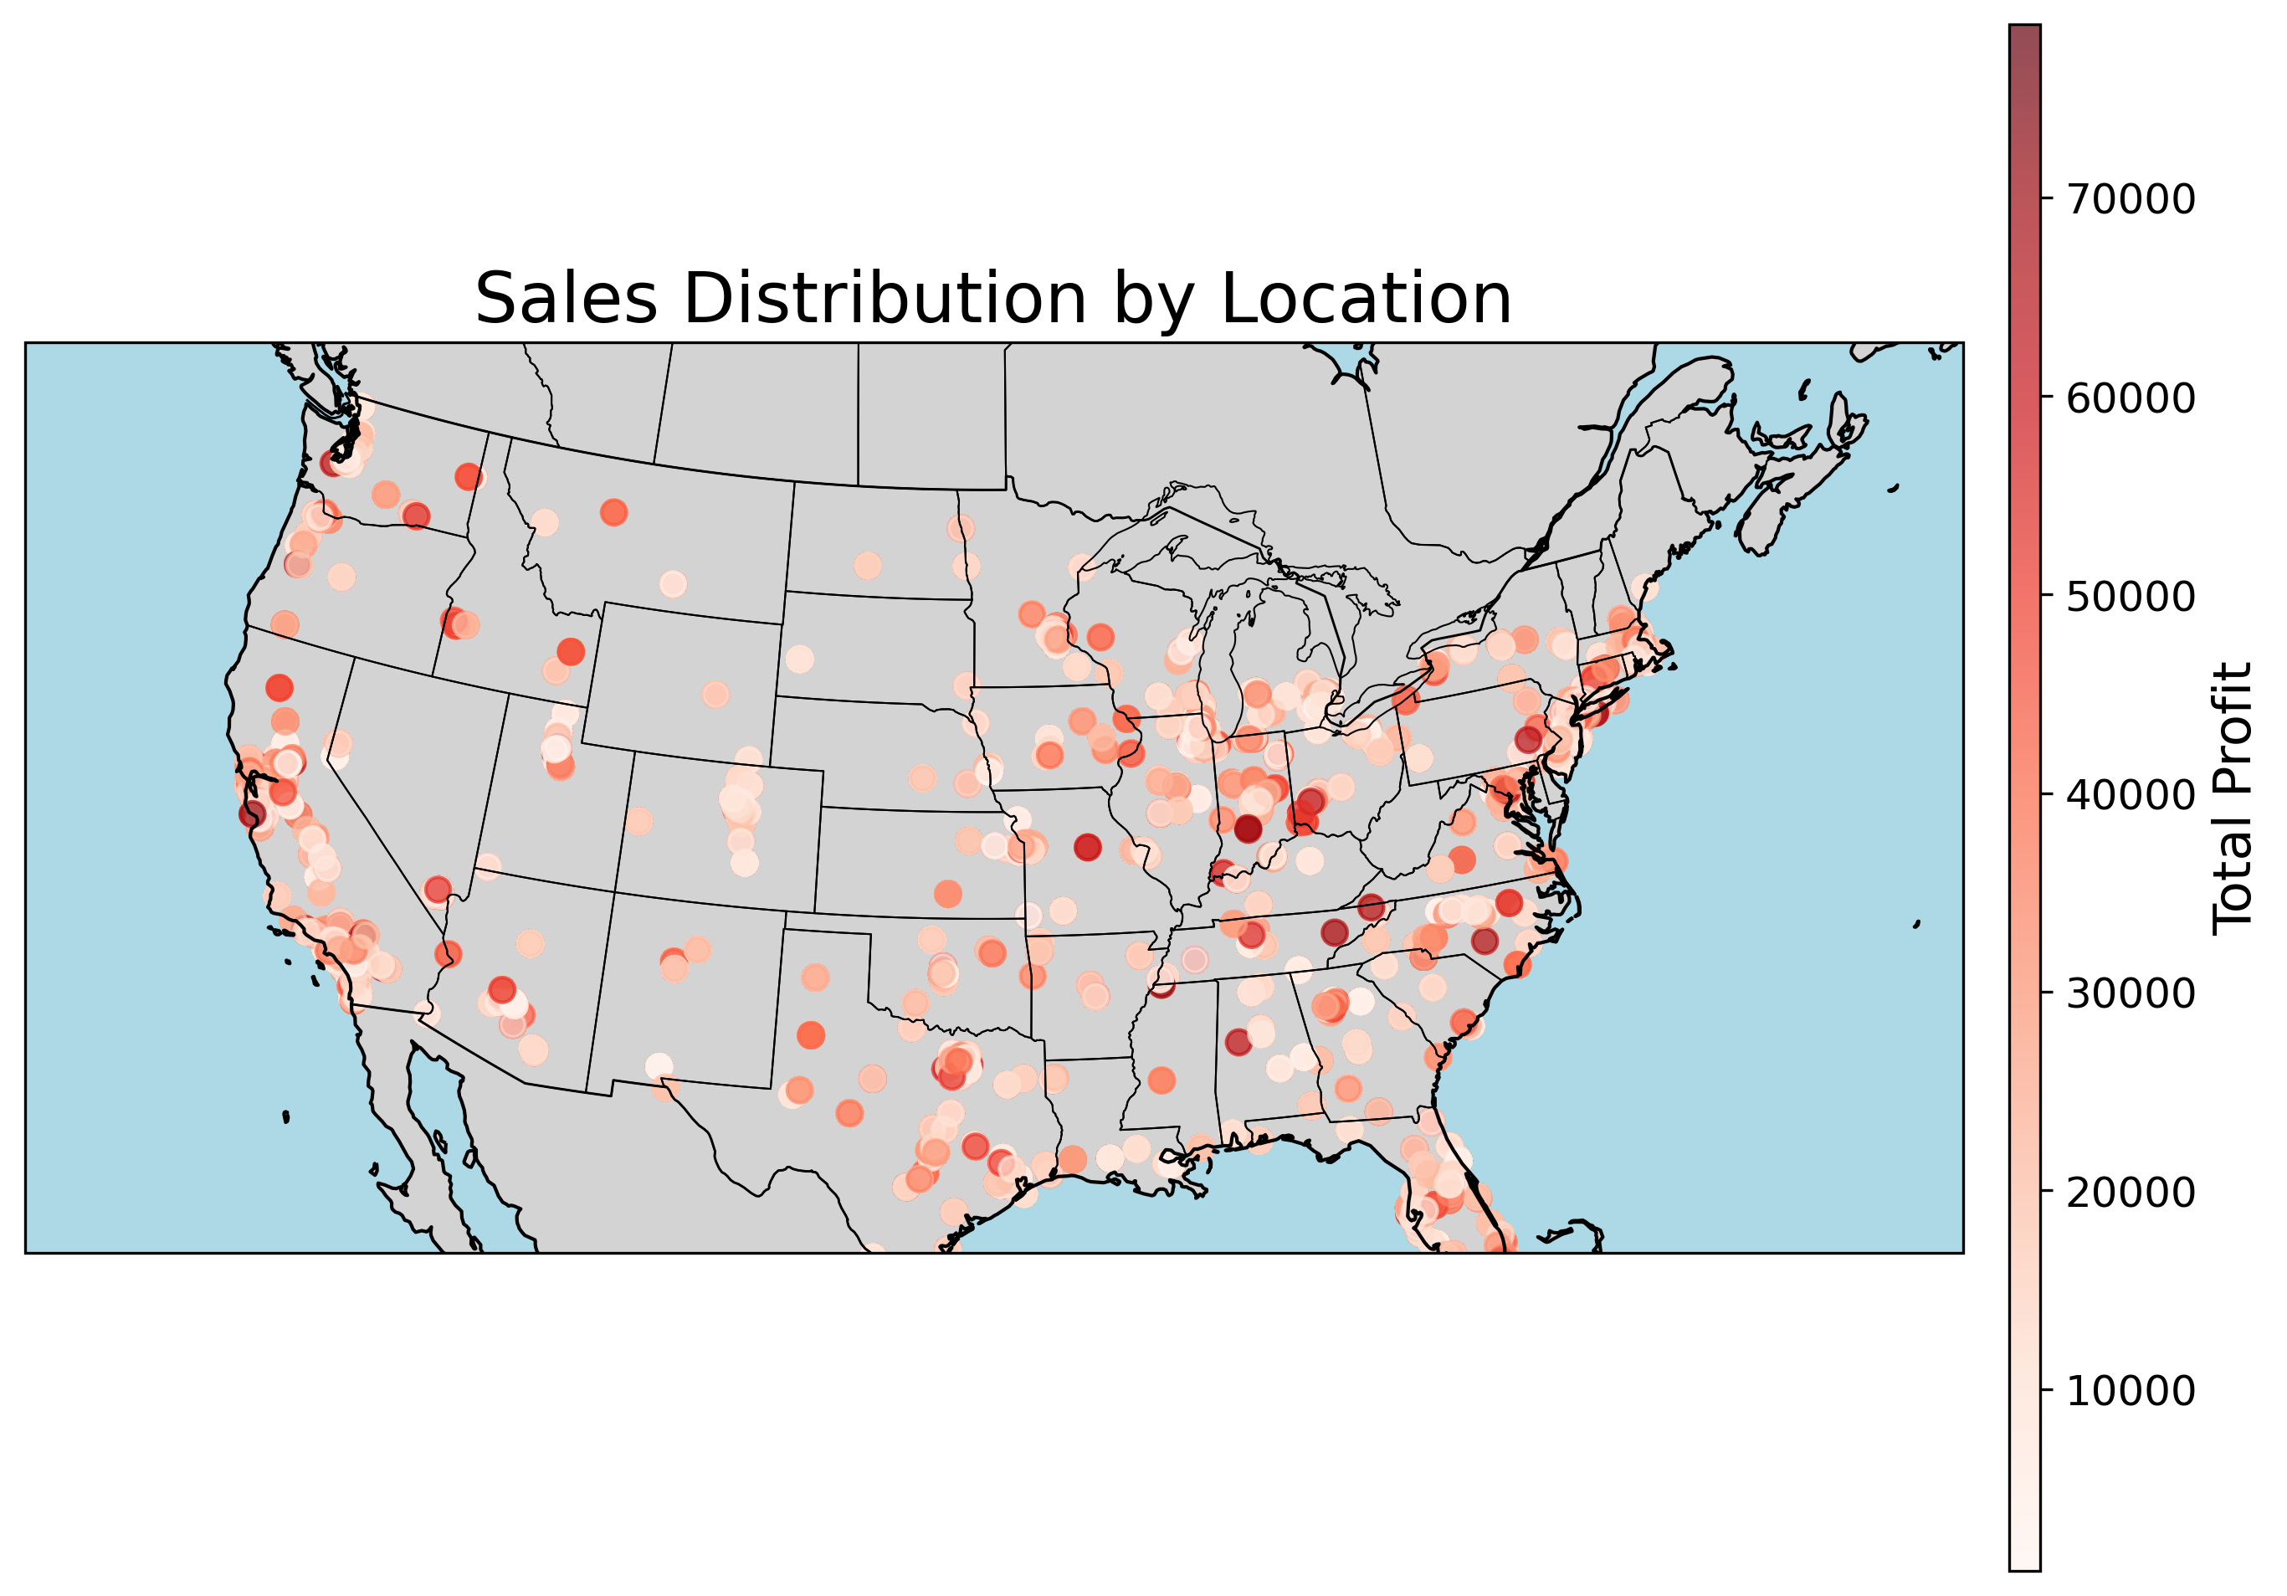
Sales distribution by location
Sales are widespread across the U.S., but concentrated in major population centers.
East Coast shows the highest number of transactions, but profits per location are lower.
West Coast locations generate fewer transactions overall, but higher profits per sale.
This suggests West Coast customers may spend more on average or buy higher-margin products.
Geography matters: regional differences in spending behavior drive profit distribution.

Slide 12
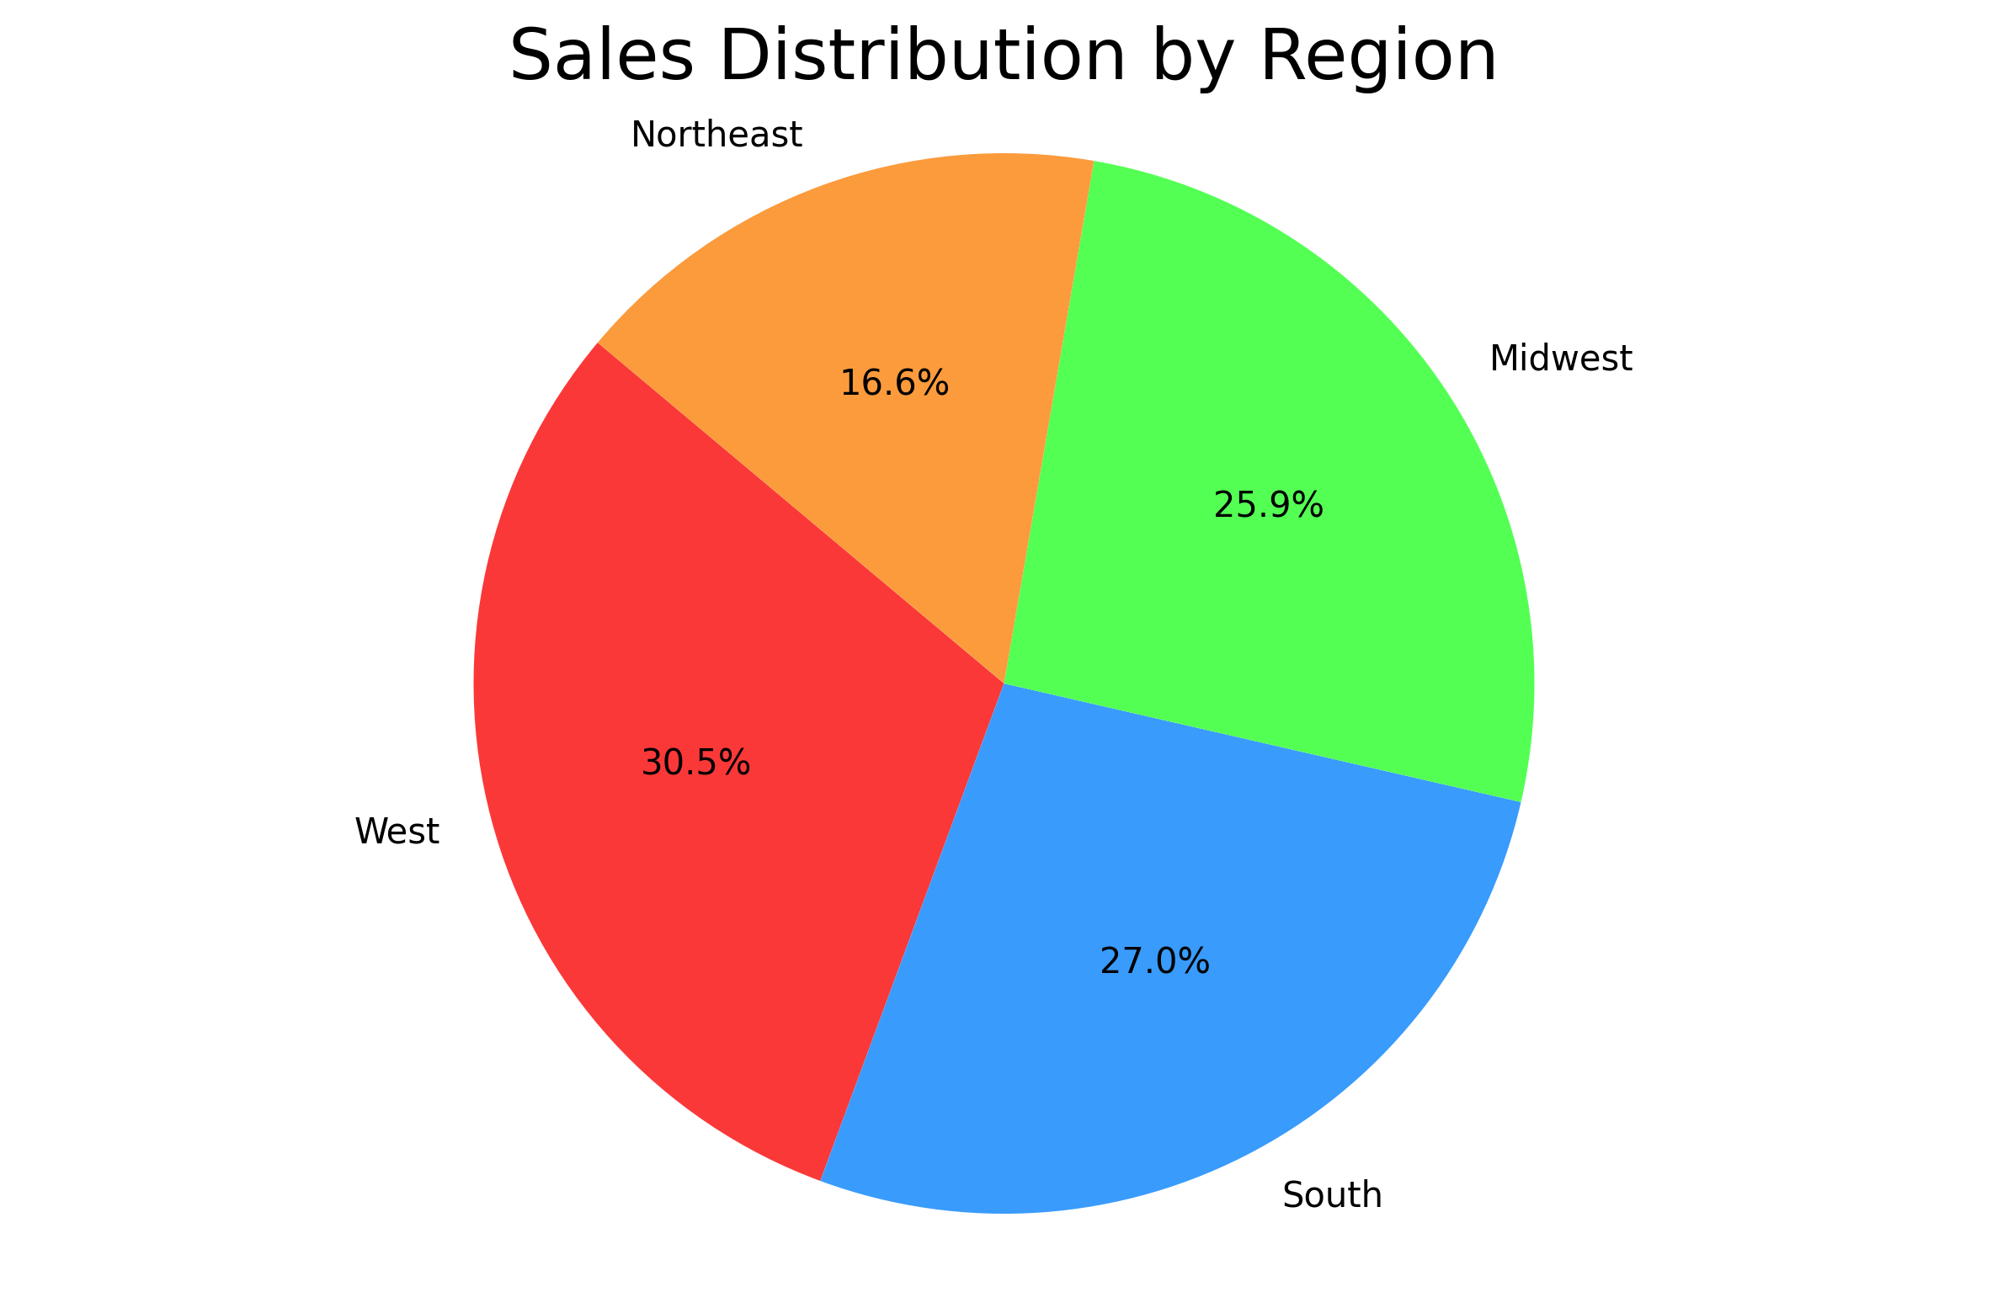
Sales distribution by region
West, Midwest, and South have the strongest sales distribution, each within 5% of one another.
The West is the strongest region, contributing 30.5% of total sales.
The Northeast is the weakest region, contributing just 16.6% of total sales.

Slide 13
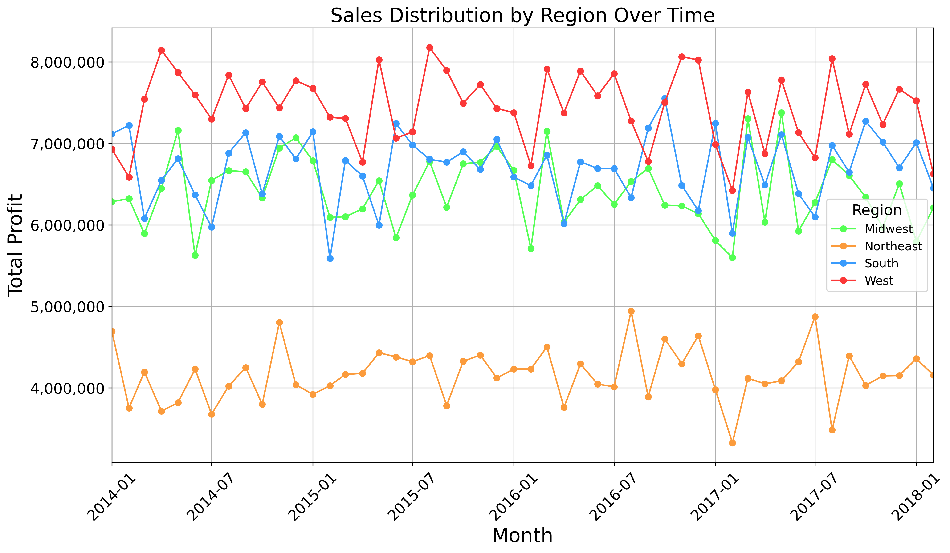
Sales distribution by region (2014 - 2018)
South, West, and Midwest often overlap, with each outperforming the others at different times.
The West is the strongest region, consistently earning above $8 million in profit and rarely dropping below $7 million.
The Northeast is the weakest region, rarely exceeding $4.5M in profit.

Slide 14
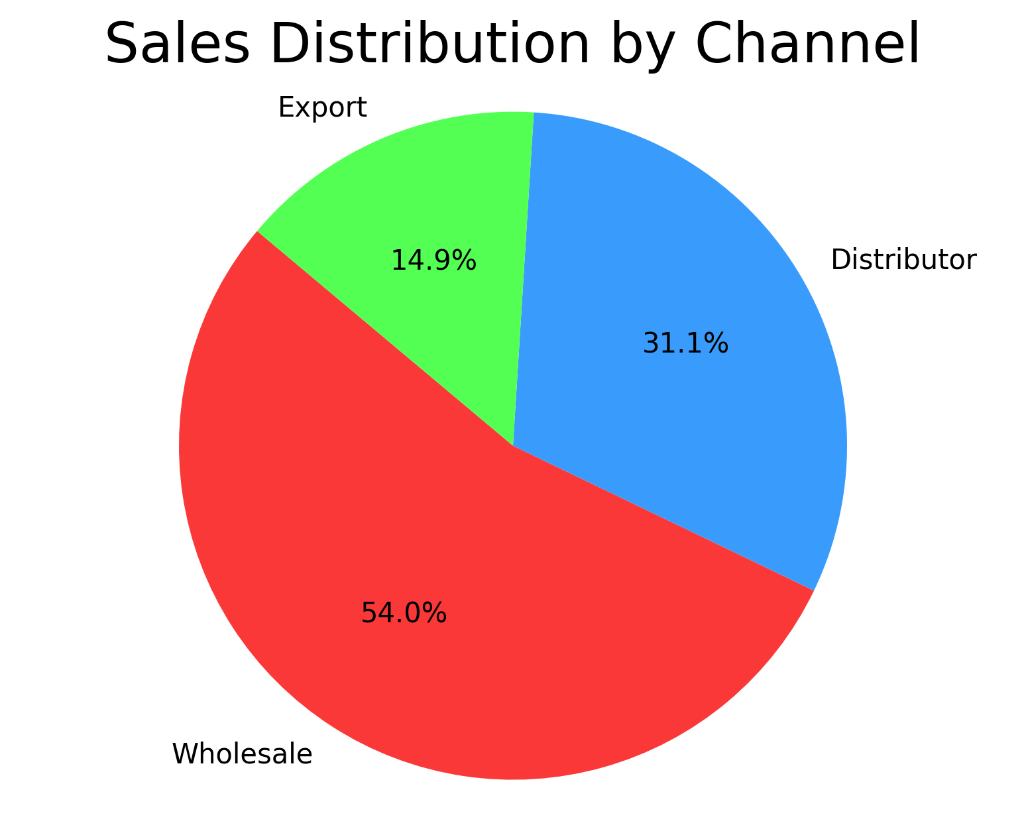
Sales distribution by channel
Wholesale vastly outmatches other distribution methods, accounting for 54% of total sales.
Exports contribute just 14.9%

Slide 15
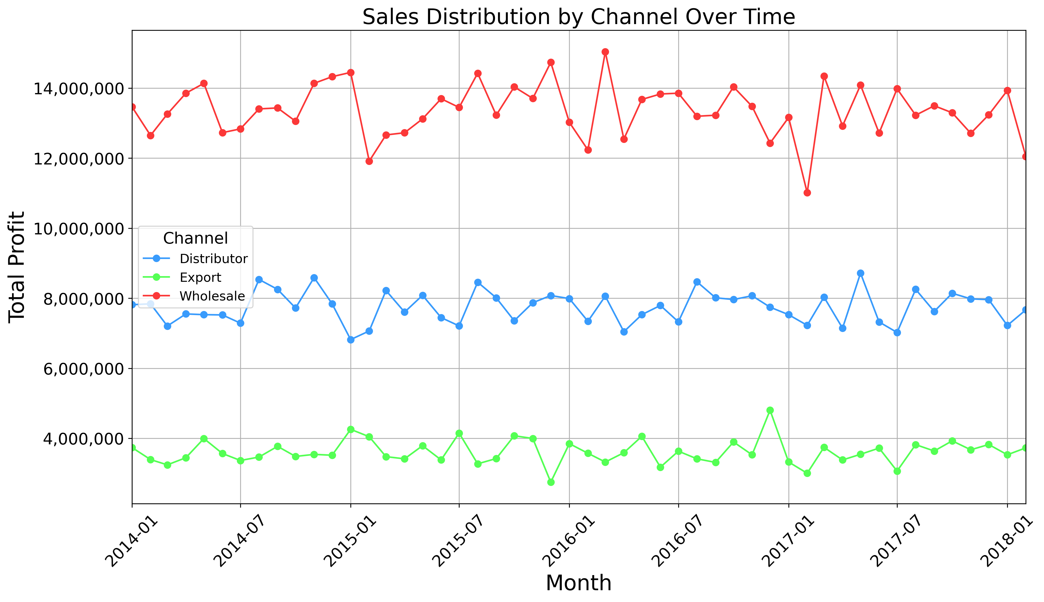
Sales distribution by channel (2014 - 2018)
Wholesale: Typically ~$14M; occasionally higher, with two dips below $12M.
Distributor: Around $8M consistently.
Export: Usually below $4M, with occasional spikes above.

Slide 16
Key insights
📍 West, Midwest & South strong; Northeast lags.
📉 Profits dip post-holidays; West stays $7–8M+.
💰 Product 26 leads ($117M, 9.5% of total).
👥 Bottom-10 customers < $5M profit each.
🚚 Wholesale dominates; Export weakest.

Slide 17
Recommendations
🔍 Investigate bottom-10 customers’ low sales to uncover opportunities.
📈 Invest in Northwest region to grow local market share.
🌍 Boost advertising & investment in exports to drive international sales.
📊 Launch targeted promotions for underperforming products.
🤝 Strengthen relationships with top-performing distributors.
💡 Analyse seasonal trends to optimize inventory and marketing.
🛠 Improve supply chain efficiency for faster delivery.

